Slide 1
What are three conclusions we can make about Kickstarter campaigns given the provided data? Plays make up 25% of all kickstarter projects, with 69% (694 out of 1004) success. This is the largest population of projects in any one subcategory, showing that this is a heavily supported area with patrons spanning globally Campaigns created towards the end of the year are the least successful; one possible explanation is the distractions from the Holidays Campaigns started at the beginning of the year are more likely to succeed compared to the failure rate What are some of the limitations of this dataset? Aside from Q1 2017, there are no other measurements of live projects; hence we cannot determine if the number of competing projects could be a factor in the funding performance What are some other possible tables/graphs that we could create? - I would create a graph that overlays the goal amount on top of the “Date Created” to see if goal amount is a contributing factor in addition to the time of year the campaigns are created.

Slide 2
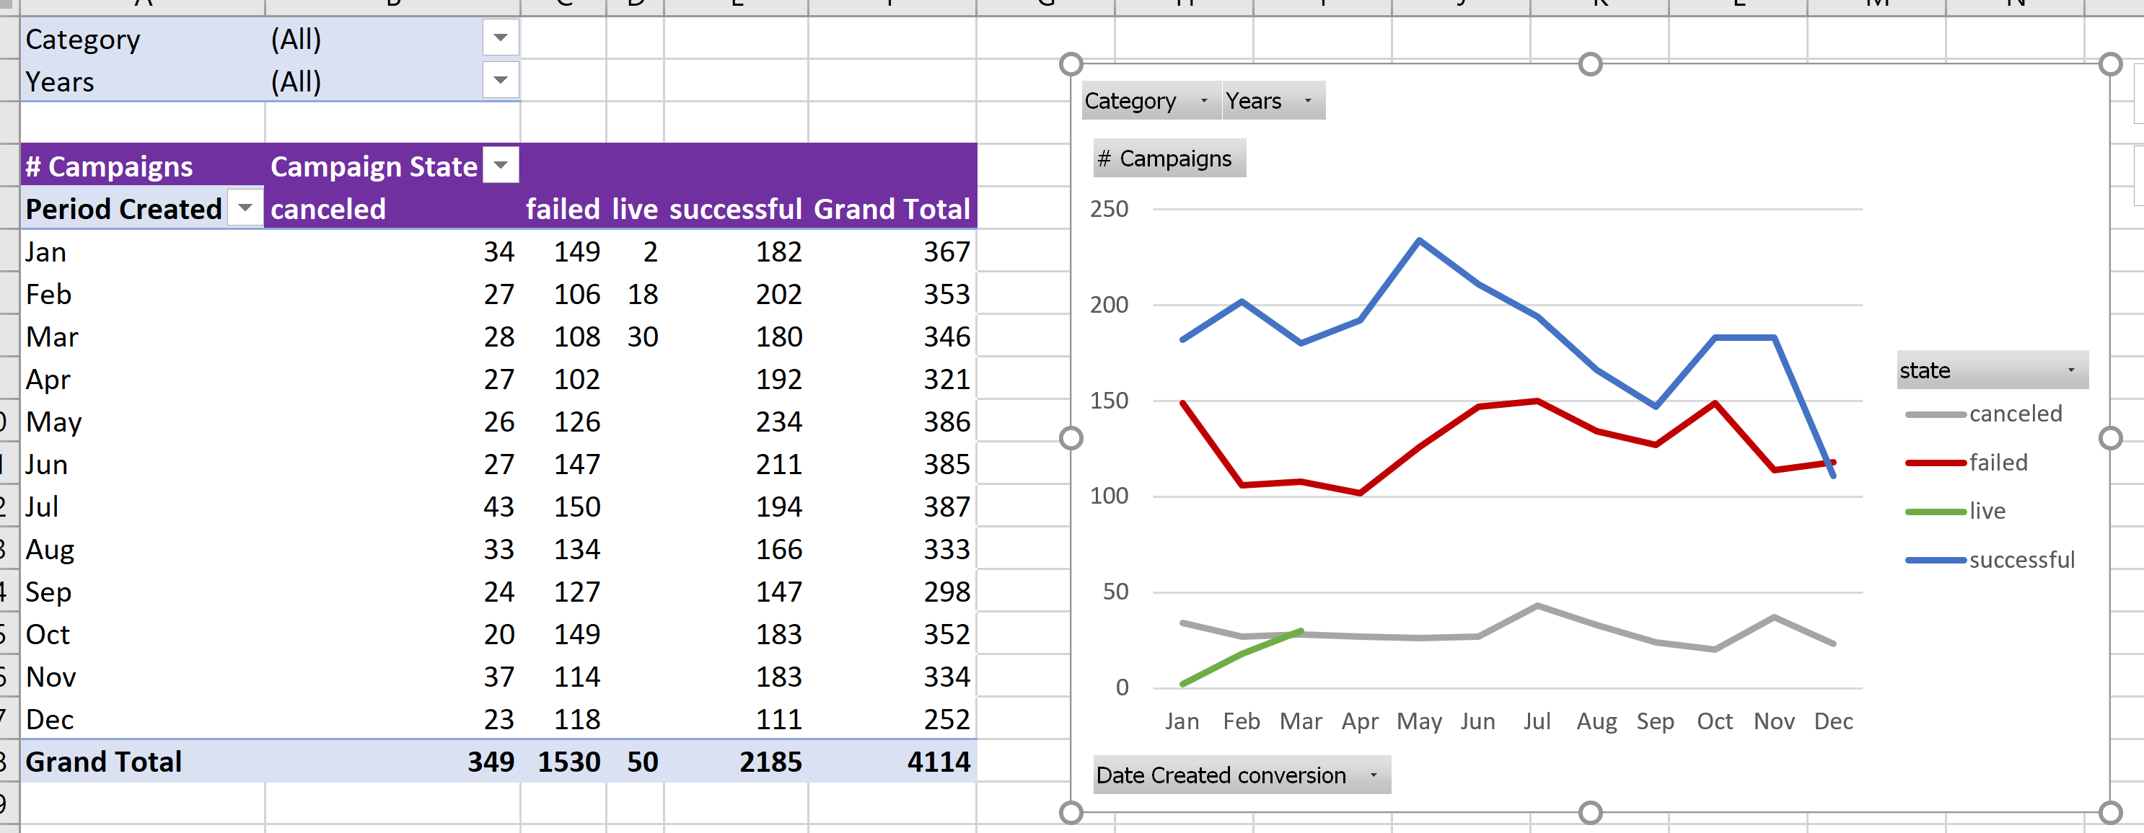

Slide 3
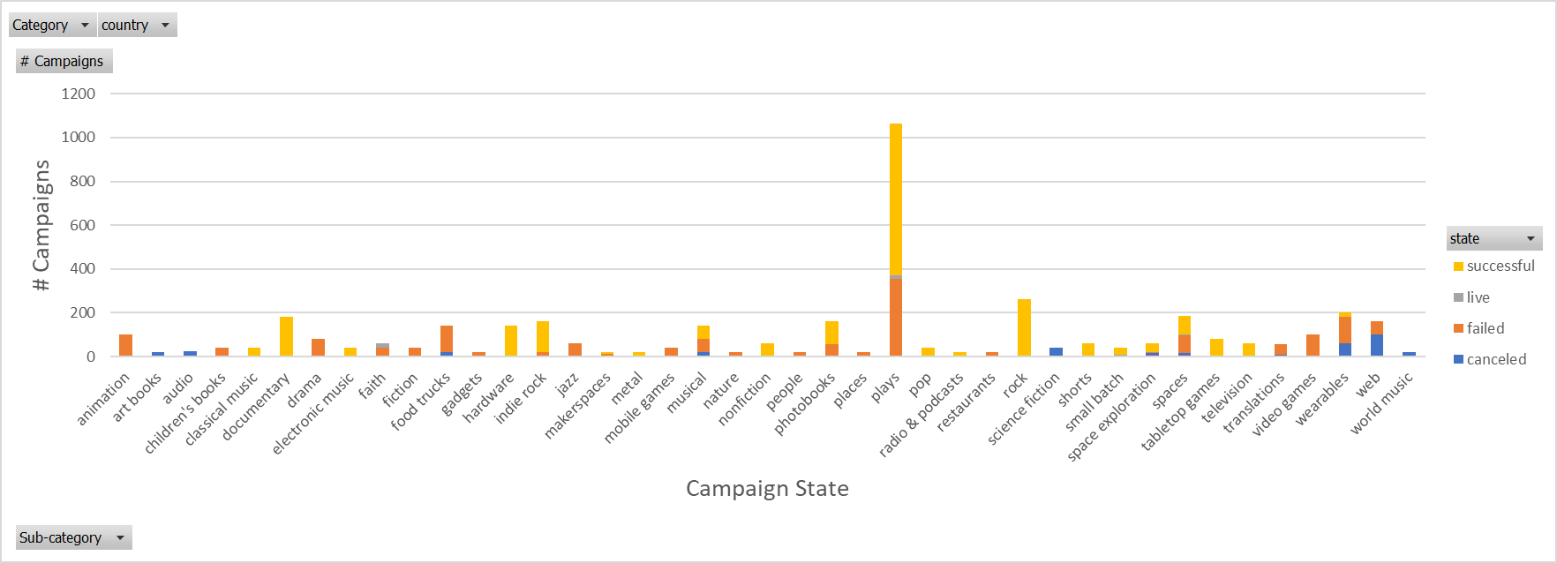
Subcategory
Plays make up 25% of all kickstarter projects, with 69% (694 out of 1004) success. This is the largest population of projects in any one subcategory, showing that this is a heavily supported area with patrons globally

